Slide 1

Creation of Workforce Insights Dashboard for Employee Skill and Analytics Group 1
An AI-Powered Workforce Analytics Platform — Attrition Prediction · Skill-Gap Detection · AI Recommendations · RAG Assistant · Interactive Dashboards
15,000 Employees
63 Engineered Features
2 ML Models
RAG Chatbot
Web + Power BI Dashboards
Infosys Springboard Internship Program • Group 1 • Complete Project Documentation

Slide 2
THE CHALLENGE
Problem Statement
1
Attrition is bleeding talent
Roughly one in three employees leaves the organisation, yet HR only reacts after resignation letters are filed.
HEADLINE RETENTION METRIC
32.3%
2
Skill gaps surface too late
Without a predictive lens, training needs are identified only during performance reviews — long after productivity has suffered.
of employees in the dataset have left the organisation
3
Insight is scattered
Attrition, satisfaction, workload and skill data live in disconnected spreadsheets with no single source of truth.
4
No grounded decision support
HR teams lack an assistant that can combine predictive analytics with the organisation's own policy knowledge.
PROBLEM STATEMENT
02 / 12

Slide 3
WHAT WE SET OUT TO DO
Project Objectives
1
Predict Attrition Risk
2
Detect Skill Gaps
Score every employee's likelihood of leaving using a trained classification model.
Flag employees with functional/skill deficiencies using a proxy risk model.
3
Automate HR Actions
4
Enable Policy Q&A
Convert ML probabilities into rule-based, ready-to-execute HR recommendations.
Ground a RAG chatbot in the organisation's HR knowledge base for instant answers.
5
Visualise Everything
6
Support Better Decisions
Present insights through an interactive web dashboard and a Power BI report.
Give HR a single, data-driven view to prioritise retention and training spend.
OBJECTIVES
03 / 12

Slide 4
OUR APPROACH
The Solution — One Connected Pipeline
A single, reproducible pipeline turns a raw HR export into predictions, recommendations and dashboards — with no manual hand-off between stages.
Raw Data
Cleaning &
Feature Eng.
ML Models
AI Recs +
RAG
Dashboards
Layer | Technology
Data & Feature Engineering | Python, Pandas, NumPy, Jupyter
Database | PostgreSQL 15 on Supabase (Session Pooler, SSL)
Machine Learning | Scikit-learn (Random Forest), LightGBM, Joblib
Recommendation Engine | Python rule-based logic → JSON output
RAG / AI Assistant | FAISS + TF-IDF, BM25, Groq Cloud API
Backend / Frontend | FastAPI, SQLAlchemy + pg8000, Jinja2, Chart.js
WHY IT MATTERS
Reproducible, script-driven pipeline — no manual steps
Same trusted features feed ML, recommendations & dashboards
Retention actions are generated automatically, not guessed
Two complementary dashboards: web app + Power BI
SOLUTION
04 / 12

Slide 5
SYSTEM DESIGN
End-to-End Architecture
Raw Employee
Dataset (Kaggle)
Data Cleaning &
Feature Engineering
PostgreSQL
Database
Machine Learning
Models
15,000 rows · 32 cols
→ 63 columns
Supabase
Random Forest · LightGBM
click →
click →
click →
AI Recommendation
Engine
RAG Knowledge
Assistant
Backend API +
Dashboards
Rule-based JSON
FAISS + Groq
FastAPI · Power BI
click →
click →
click →
ARCHITECTURE
05 / 12

Slide 6
STAGE 1
⌂ Architecture
Data & Preprocessing
15,000
32 → 63
OUTLIER SCAN — TOP FLAGGED COLUMNS (IQR METHOD)
Employee Records
Columns After Feature Eng.
0
0
Missing Values
Duplicate Rows
Cleaning workflow: structural inspection → missing-value & duplicate checks → category standardisation → business-rule validation → IQR outlier review → binary encoding.
KEY ENGINEERED FEATURES
burnout_risk_score Overtime + absence + workload
overall_satisfaction_index Avg. of 4 satisfaction measures
career_stagnation_flag Long role tenure, no promotion
commute_burden_index Commute time vs. distance
income_percentile_in_dept Pay rank within department
Flagged values were reviewed and retained as plausible real-world data — none were dropped or capped.
DATA & PREPROCESSING
06 / 12

Slide 7
STAGE 2
⌂ Architecture
Machine Learning Models
MODEL 1 — ATTRITION PREDICTION
MODEL 2 — SKILL-GAP PREDICTION
TOP 6 FEATURES DRIVING ATTRITION
ATTRITION MODEL — CONFUSION MATRIX (TEST SET, n=3,000)
 | Pred: Stay | Pred: Leave
Actual: Stay | 1,875 | 156
Actual: Leave | 578 | 391
Overall Accuracy: 75.53% Recall (Leave): 40%
Skill-gap model measures a synthetic proxy label (tenure, pay, promotion, performance) — a best-available risk indicator until a validated HR skills assessment exists.
MACHINE LEARNING
07 / 12

Slide 8
STAGE 3
⌂ Architecture
AI Recommendation Engine
Turns raw ML probabilities into targeted, human-readable HR actions using deterministic, rule-based logic.
Attrition &
Skill-Gap Probabilities
Rule Engine
(Threshold Logic)
Structured
JSON Output
Actionable
HR Instruction
Trigger | Meaning | Recommended Action
Attrition Prob > 0.70 | High flight risk | Immediate 1-on-1 & compensation review
Attrition Prob > 0.40 | Moderate flight risk | Stay interview & workload check
Skill Gap > 0.60 | Significant skill deficiency | Mandatory technical upskilling bootcamp
Skill Gap > 0.30 | Minor skill deficiency | Assign a senior mentor
AI RECOMMENDATION ENGINE
08 / 12

Slide 9
STAGE 4
⌂ Architecture
RAG Knowledge Assistant
A retrieval-augmented chatbot that answers workforce-policy questions using only the project's own HR knowledge base — and says so when it can't.
HR Knowledge Base
(5 Markdown docs)
Structured Chunking
(12 chunks)
Hybrid Retrieval
TF-IDF/FAISS + BM25
Reciprocal Rank
Fusion (RRF)
TF-IDF Cosine
Reranking
Context
Expansion
Groq LLM →
Grounded Answer
TECH STACK
Python
LangChain
scikit-learn TF-IDF
FAISS IndexFlatIP
BM25
Groq Cloud API
WHY IT'S GROUNDED, NOT GENERIC
The LLM prompt restricts answers strictly to retrieved context, and the model explicitly states when information isn't in the knowledge base — avoiding hallucinated HR policy.
RAG ASSISTANT
09 / 12

Slide 10
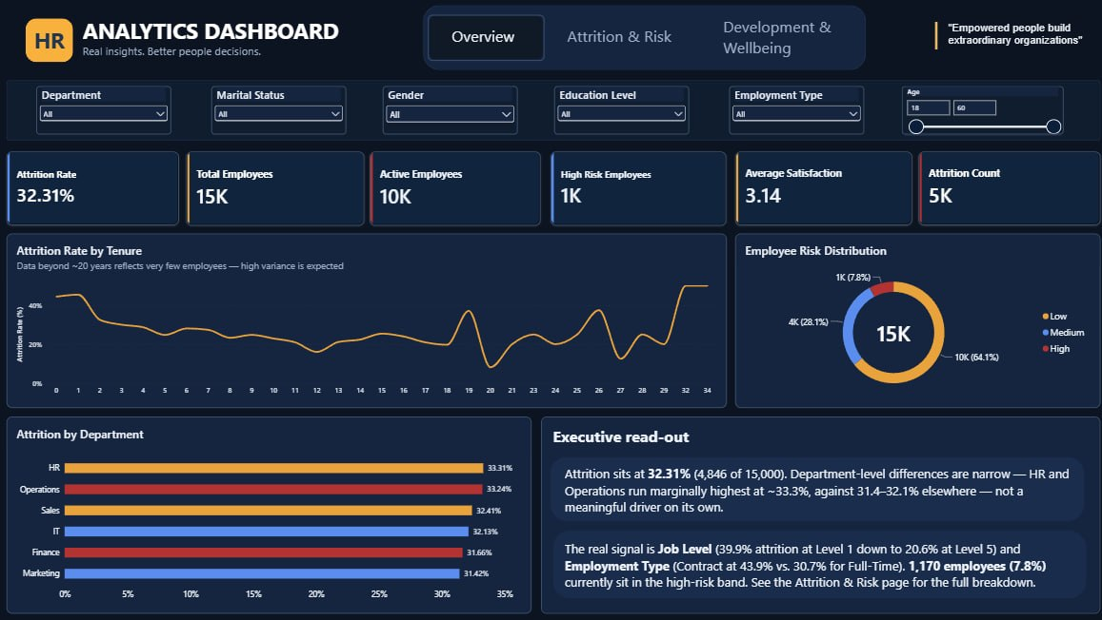
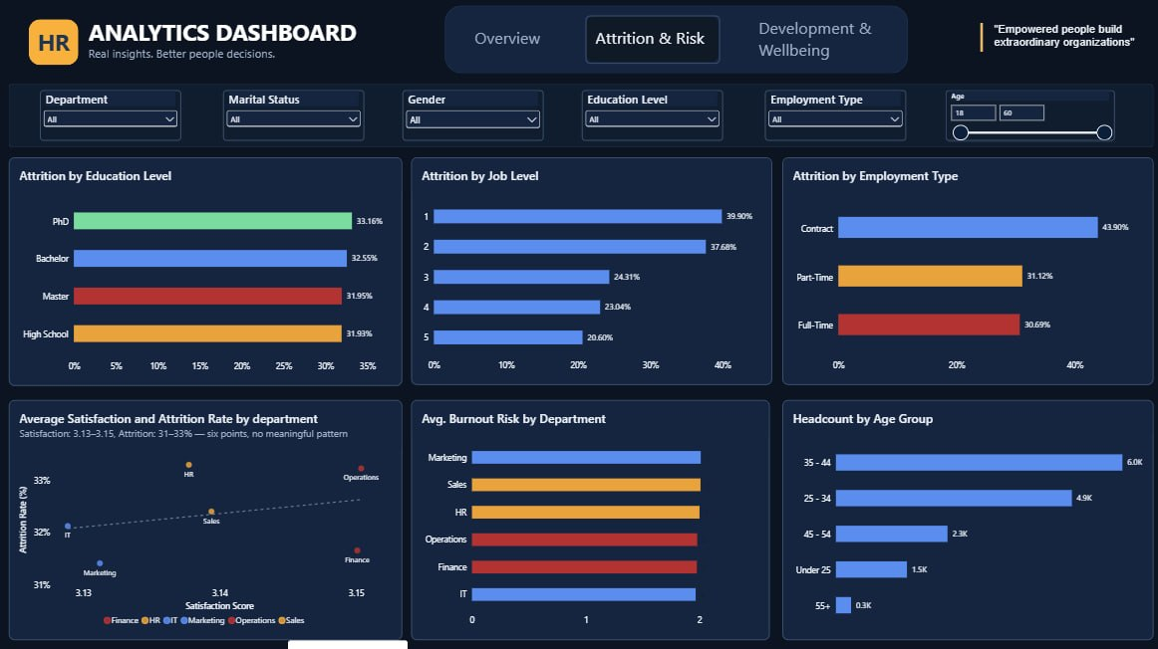
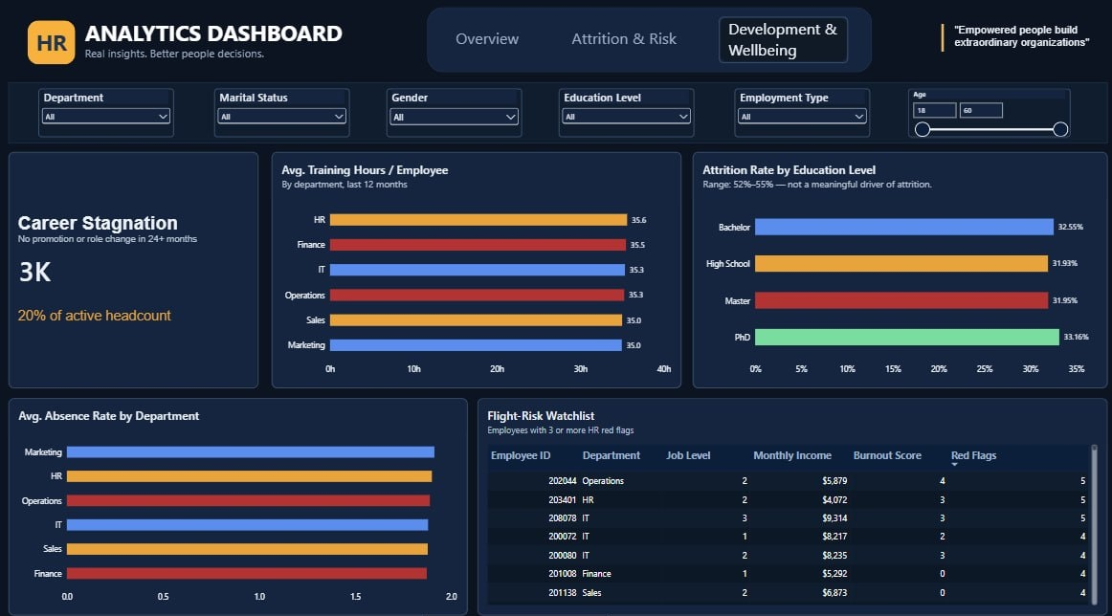
STAGE 5
⌂ Architecture
Interactive Dashboards
Delivered as a live Power BI report — three linked pages, six cross-filters, and drill-through KPIs.
Overview
Attrition & Risk
Development & Wellbeing
LIVE, CROSS-FILTERED ACROSS ALL THREE PAGES
Department
Marital Status
Gender
Education Level
Employment Type
Age (18–60)
Overview 6 executive KPIs, risk donut, attrition-by-tenure trend & narrative read-out. Attrition & Risk Education, job level, employment type, burnout & satisfaction cross-analysis. Development & Wellbeing Career stagnation, training hours, absence and a live flight-risk watchlist.
A companion FastAPI + Chart.js web app additionally exposes 7 pages — Dashboard, Employees, Employee Details, Attrition Analysis, Skill Gap Matrix, ML Simulator and AI Recommendations — for live, code-driven access to the same models.
DASHBOARDS
10 / 12

Slide 11
OUTCOMES
Results & Impact
75.53%
79.80%
32.3%
15,000
Attrition Model Accuracy
Skill-Gap Model Accuracy
Overall Attrition Rate
Employees Analysed
details →
details →
details →
details →
STRONGEST ATTRITION DRIVERS (WORK-ARRANGEMENT FACTORS)
KEY TAKEAWAY
Overtime shows the single largest gap (~22.6 points), and low job satisfaction roughly doubles attrition risk. Leavers also average just ~2 years tenure vs. ~4 for stayers.
RESULTS & IMPACT
11 / 12

Slide 12
WRAPPING UP
Conclusion & Future Scope
This project delivers a complete, reproducible workforce-analytics pipeline: from a raw 15,000-employee dataset to trained ML models, automated HR recommendations, a grounded RAG assistant, and dual dashboards — giving HR one connected view of attrition and skill risk.
FUTURE SCOPE
Thank You
Build out Module 7 explicitly — workforce health scores, talent-risk indicators & confidence-scored learning recommendations, currently only implicit in the pipeline.
Creation of Workforce Insights Dashboard for Employee Skill and Analytics
Expand the RAG knowledge base with the organisation's real HR policies, beyond representative templates.
TEAM — GROUP 1
Deploy the backend, PostgreSQL database and RAG service to a production host with authentication.
Anil · Gowtham · Harshitha · Santhosh · Satish · Srishti · Surendhar · Thivya
Infosys Springboard Internship Program
Replace the skill-gap proxy label with a validated, real-world HR skills assessment target.
github.com/srishtimishra30/Creation-of-Workforce-Insights-Dashboard-for-Employee-Skill-and-Analytics

